Slide 1
Human Interaction
“How do social environments and biological factors influence human behavior?”
Helen Zewdu, Oluwatomisin Kale, India Crowe

Slide 2
Data Selection/Exploration
Data Selection
Measured behavioral attributes such as time spent alone, going outside, social acceptance, etc.
Measured psychological tendencies such as: feeling drained after socializing and stage fear.
We focused on the different tendencies of these behaviors between introverts and extroverts.
Rows: 2900
Columns: 8 variables

Slide 3
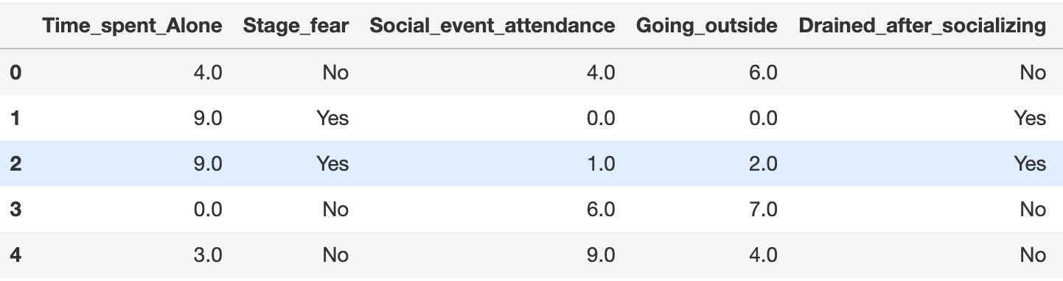
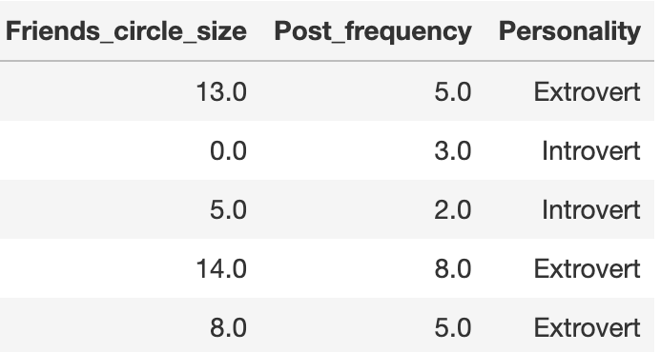
Data Selection/Exploration
5 numerical values
3 categorical values
0 missing values
This analysis helps us clean and fully understand our data, especially because we have 0 missing values.

Slide 4
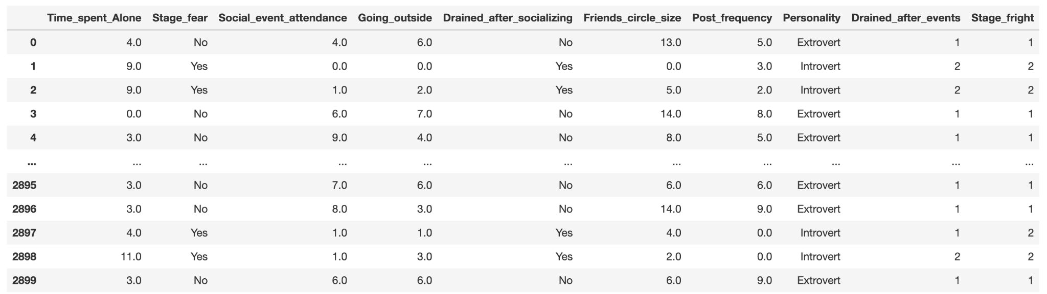
Data Wrangling
Checked for missing values within our data, output showed none.
Checked how many rows in our data were duplicated: 402 duplicates.
Created new variables so that our data analysis can be simplified: Drained_after_events and Stage_fright.

Slide 5
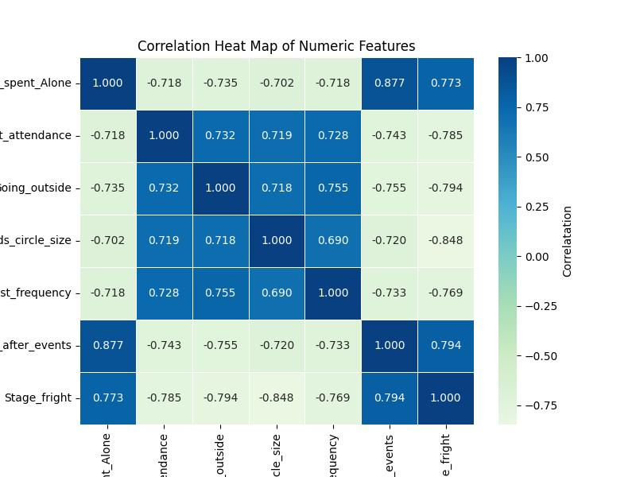
Visual Insights
Strong negative correlations:
Time spent alone and--->
Going outside
Social event attendance
Friend circle size
Strongest Correlations:
Time_Spent_Alone and Drained_after_Events: strong positive correlation.
Friend_circle_size and Stage_Fright: strong negative correlation

Slide 6
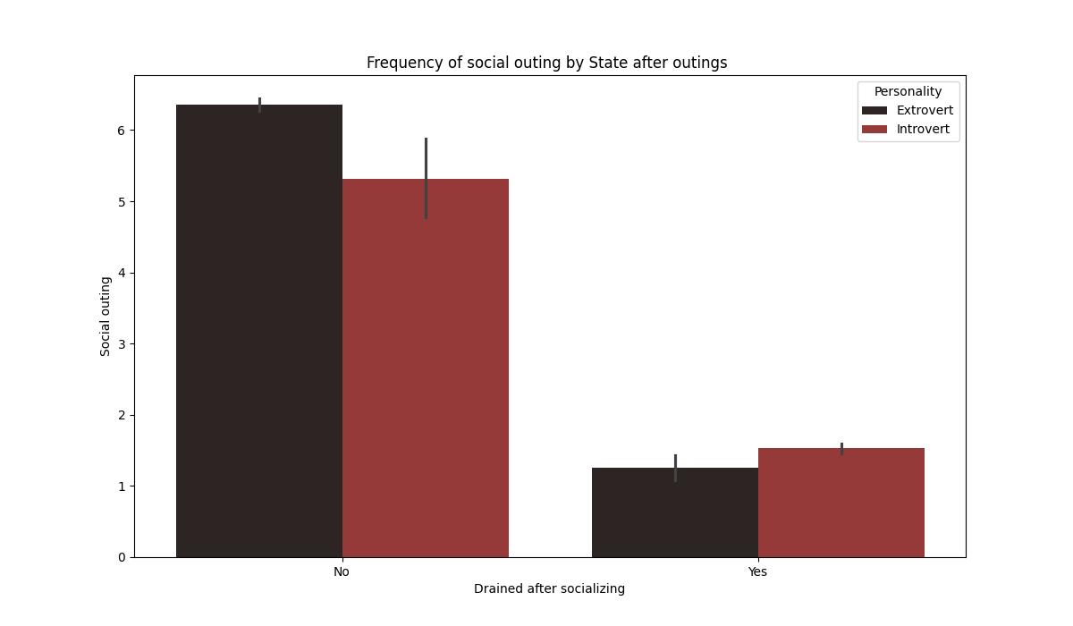
Bar Plot
Shows how much individuals engage in social outing after being socially drained.
Regardless of the personality type, all individuals who feel more drained after socializing engage in social outings less.
Barplot shows that sociability has a significant impact on social outings regardless of ones personality.

Slide 7
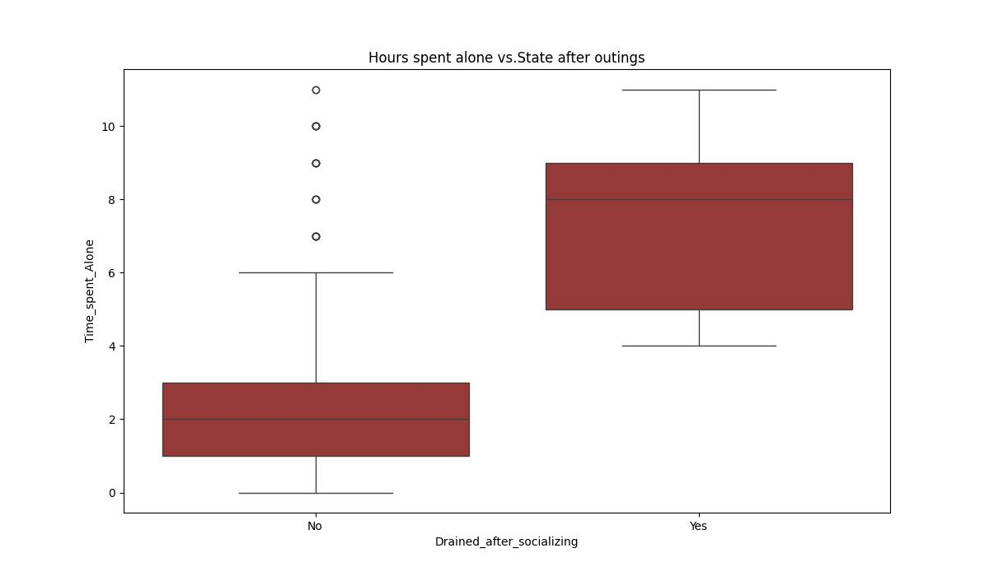
Boxplot
Not drained=1-3 hrs of alone time
Difference in solitary time required by different groups based on their energy levels
Outliers shows unique cases where people do not feel drained but still choose to spend an unusually high amount of time alone.

Slide 8
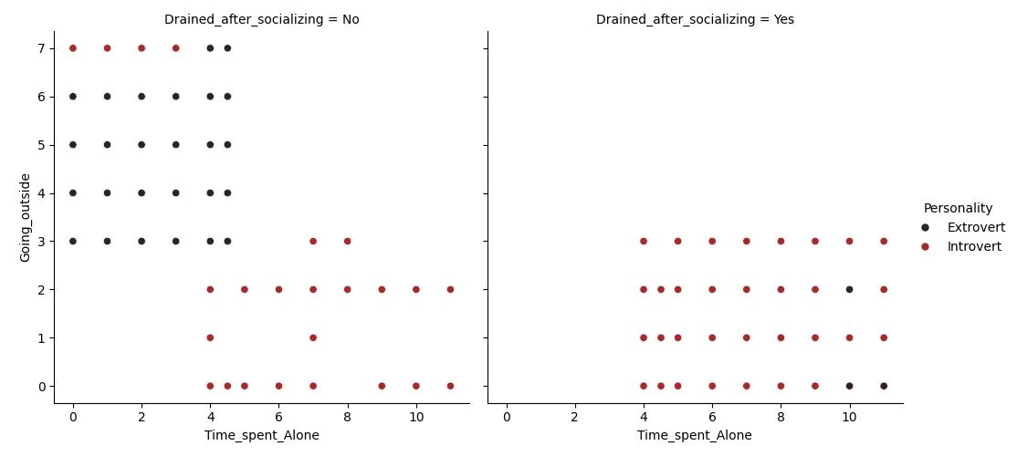
Relational plot
Negative trend
color-coded points show that while Extroverts tend to be more active overall
People who feel exhausted are clustered at the top-left, showing high solitude and low activity, while those who do not feel drained maintain a much higher spread of outdoor movement with minimal time alone

Slide 9
Conclusion
Human interaction is not a random occurrence but a balanced system of energy and preference.
Social environment + biological factors play significant roles in personality types.
Because an individual’s personality provides a biological baseline for how they process social stimulation, their state after outings acts as a gatekeeper for future movement.
Those who feel biologically recharged by others are more likely to engage with the world, while those who feel drained after interactions require substential solitary time to recover.
These visualization prove that while environments provide the setting for interaction, our need for energy management is what dictates the rhythm of our social lives.

